Slide 1


Decoding
Success:
Key Drivers of Board & Card Game Campaigns on Kickstarter
By: Fatima Ammar - Zahraa Alrosani - Zahra Khalaf - Ghufran Alhayki

Slide 2
Problem Statement:
Kickstarter is exploring a consulting service to help board game creators improve their campaign success. Many campaigns fail due to uninformed decisions. This analysis aims to extract clear, data-driven recommendations to support future projects.

Slide 3
 | 1
 | 2
 | 3
Aim’s:
Identify the key factors influencing the success of board and card game campaigns on Kickstarter.
Analyze the effects of launch timing, campaign duration, funding goals, reward tier pricing, backer engagement.
Provide actionable recommendations for board game creators to improve campaigns and increase success.

Slide 4
Overview:
552
261
210
Total Number of Projects
Total Number of Projects
Number of Successful Project
Number of Failed Project
8.68K
40.92
358.77
Average of Project’s Goal
Average of Project’s Duration
Average of Successful Project’s Backers

Slide 5
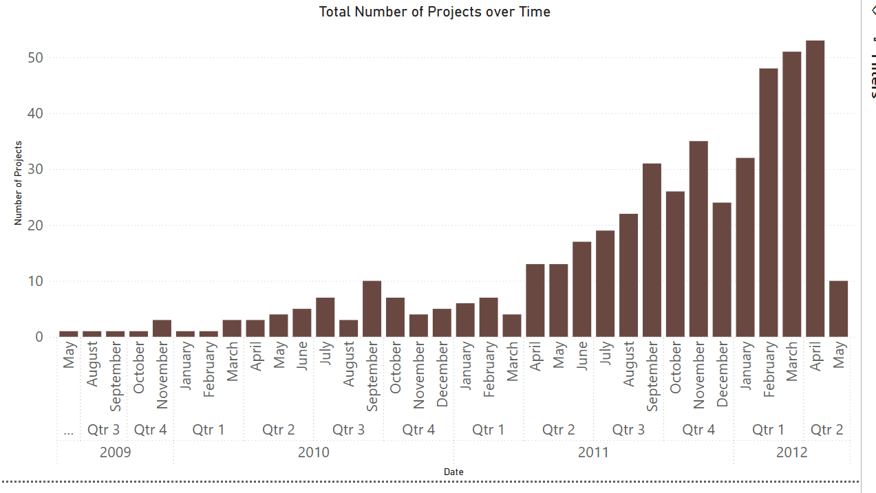
Launch Timing:

Slide 6
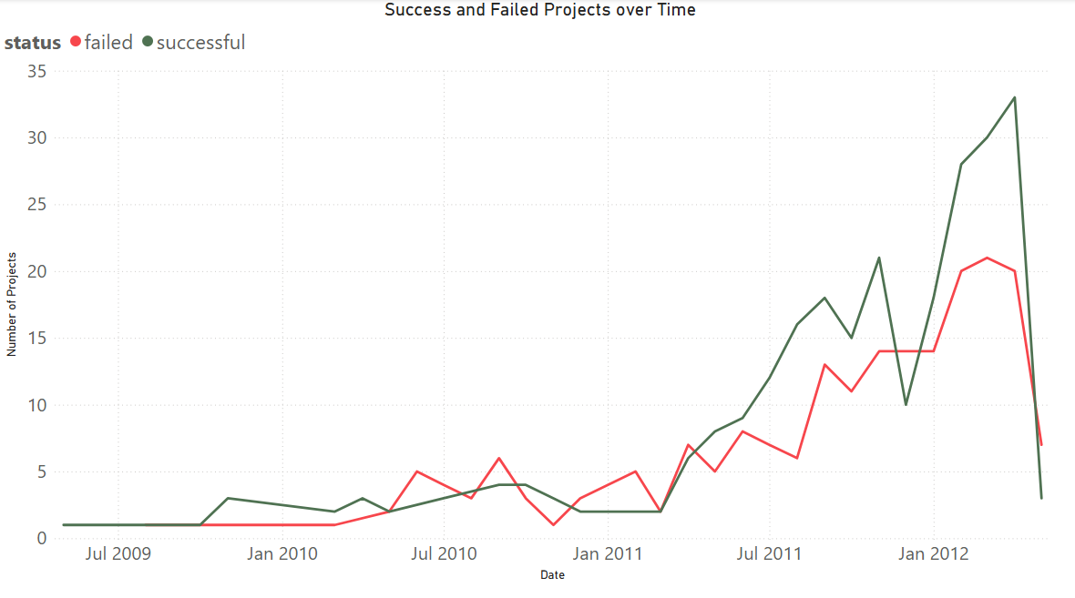
Launch Timing:

Slide 7
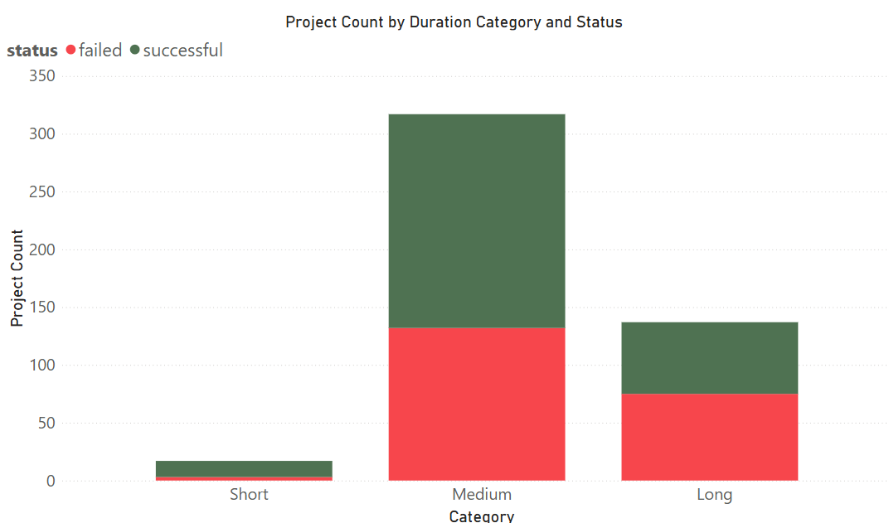
Campaign Duration:
Number of Projects per Duration
- Short : Less or equal 20 Days.
- Medium : Between 21 & 45 Days.
- Long : More than 45 Days.
Total Number of Project

Slide 8
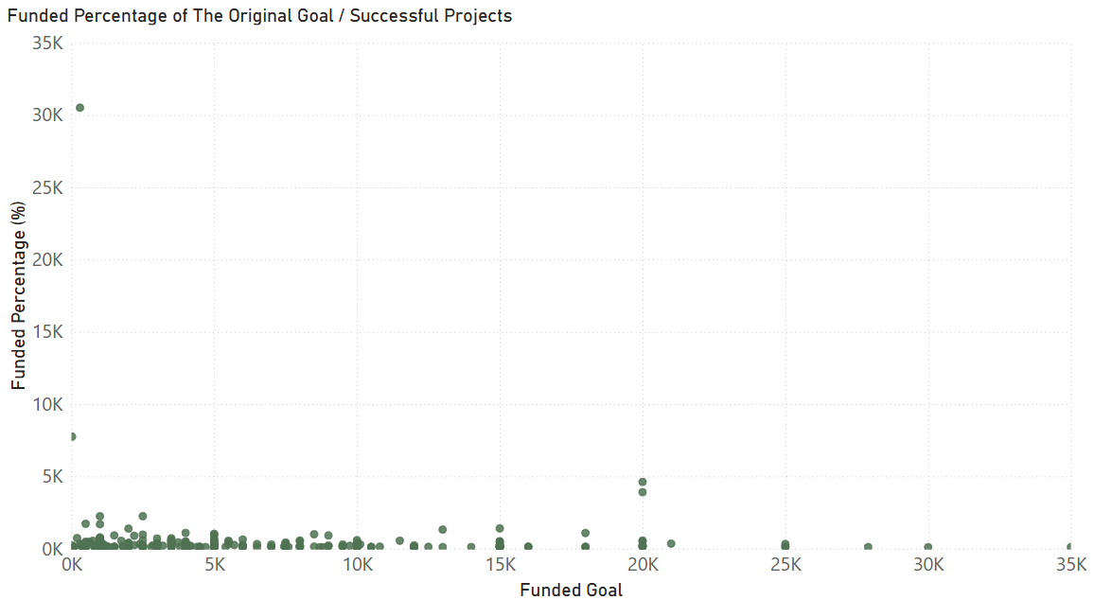
Funding Goals:

Slide 9
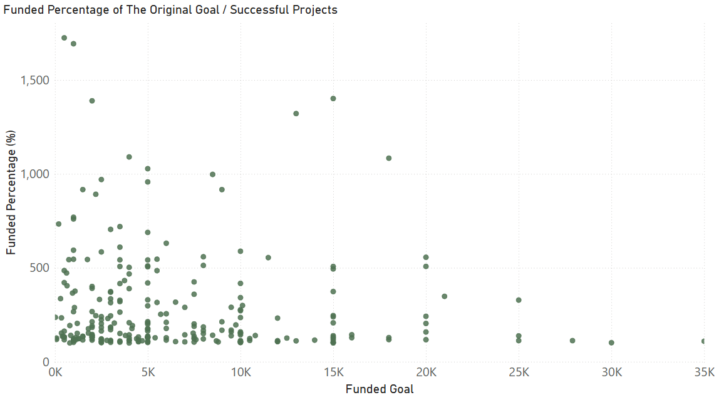
Funding Goals:

Slide 10
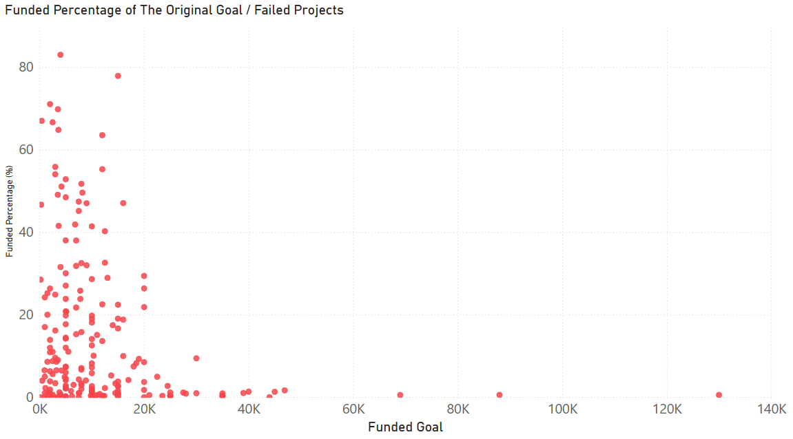
Funding Goals:

Slide 11
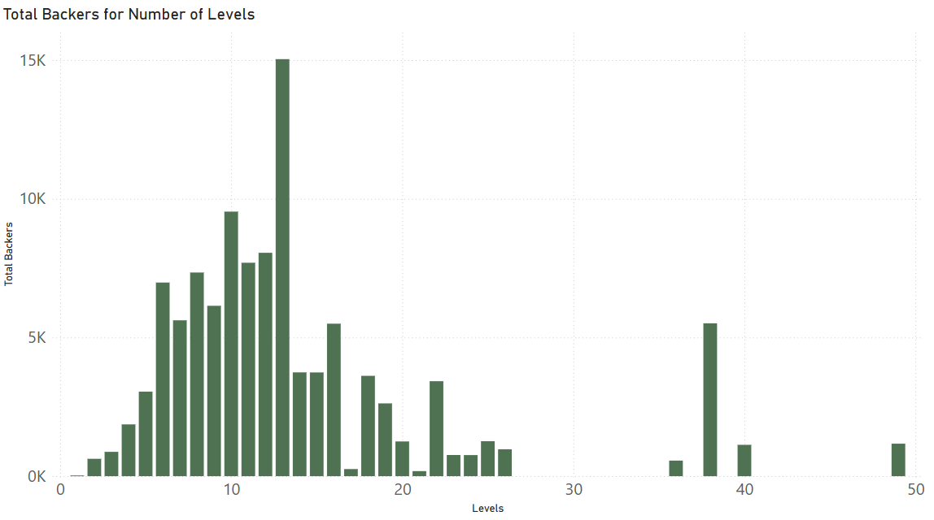
Reward Tier Pricing:

Slide 12
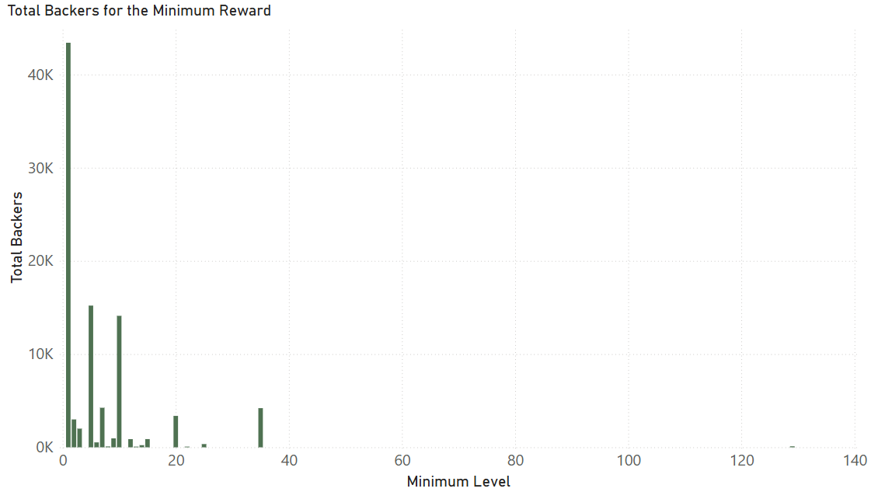
Reward Tier Pricing:

Slide 13
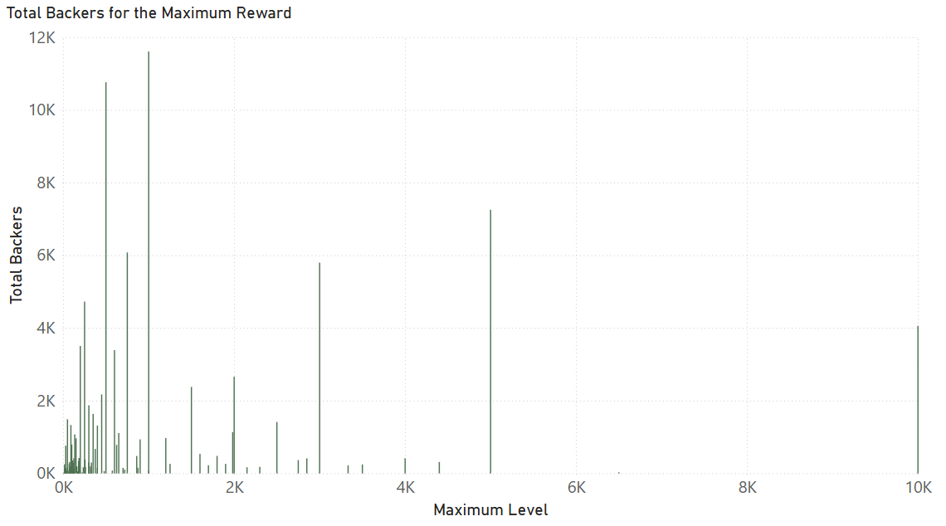
Reward Tier Pricing:

Slide 14
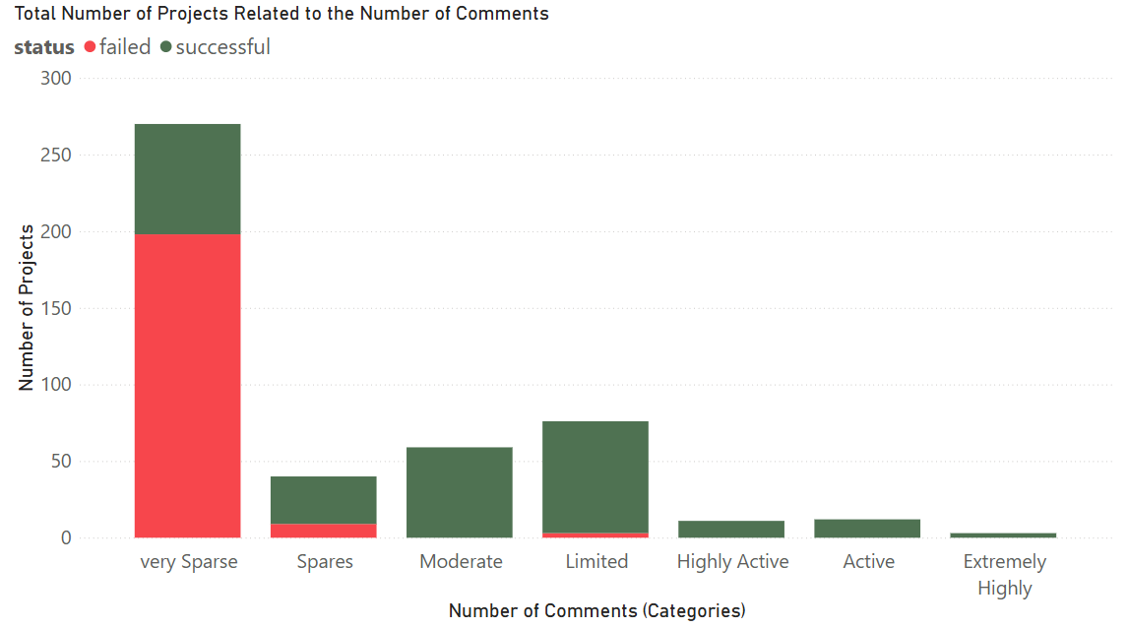
Engagement:
- very Sparse <= 10
- Spares <= 20
- Limited <= 50
- Moderate <= 150
- Active <= 300
- Highly Active <= 1000
- Extremely Highly > 1000

Slide 15
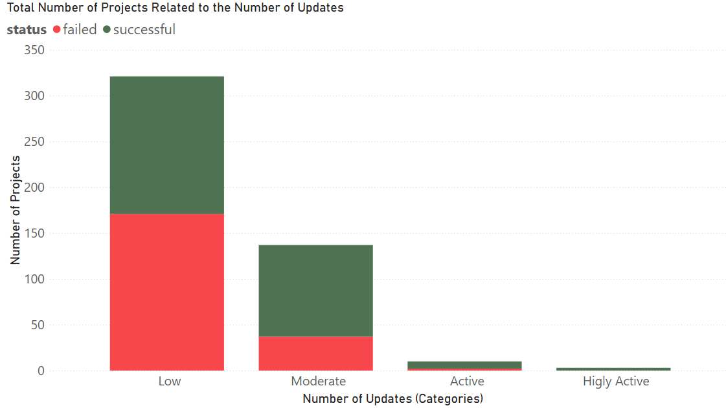
Engagement:
- Low <= 10
- Moderate <= 20
- Active <= 30
- Higley Active <= 50
- Very High Activity <= 70
- Extremely High Activity < 70

Slide 16
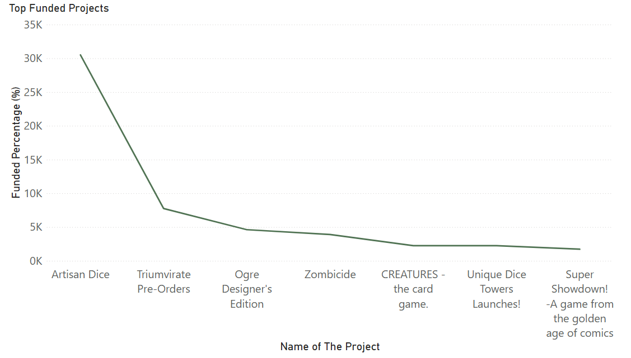
Example of high success:

Slide 17
Example of high success:
Launch Date : March 2012
Goal : 300$
Pledged : 91542$
Funded percentage : %30514
Backers : 1131
Levels : 40
Min Reward : 7$
Max Reward : 1983$
Updates : 30
Comments : 731
Duration : 29 Days

Slide 18
 | 1 |  |  |  | 5
 | 2 |  |  |  | 6
 | 3 |  |  |  | 7
 | 4
Recommendation:
Keep funding goal under $10,000
Offer higher-tier special editions for premium backers.
5 to 15 reward tiers recommended.
Minimum 10 updates throughout the campaign.
Start rewards at $1 –$10 minimum.
Encourage > 20 comments through active communication.
Target duration between 21 to 45 days.

